Slide 1
MANAGEMENT INFORMATION SYSTEMS
Chapter 5: IT Infrastructure and Emerging Technologies

Slide 2
Recap of Chapter 4
Describe IT/IS-related ethical, social, and political issues.
Describe principles for ethical conduct.
Discuss information rights and privacy issues.
Discuss intellectual property issues.
Discuss system quality issues.
Discuss accountability and control issues.
Discuss quality of life issues.

Slide 3
IT Infrastructure and
Emerging Technologies

Slide 4
IT Infrastructure
Information technology (IT) infrastructure refers to the shared technology resources that provide the platform for all information systems within a firm.
It includes investments in hardware, software, and services such as consulting, training, and education that are used across business units.
IT infrastructure forms the foundation for serving customers, coordinating suppliers, managing internal processes, and executing business strategies.
Supplying IT infrastructure worldwide was a $5.06 trillion industry in 2024, representing a major share of corporate technology spending.

Slide 5
IT Infrastructure
A firm’s IT infrastructure includes both physical devices and software applications that support the enterprise.
It also relies on a set of firmwide services, a combination of technical and human capabilities that ensure smooth and secure operation.
These services form the operational backbone of the organization, enabling consistency and integration across systems.
Together, these firmwide capabilities translate into a set of core services that deliver computing power, connectivity, and data management throughout the organization.
Let’s look at the major categories of these services in more detail.

Slide 6
Core Infrastructure Services
Computing Platforms provide the digital environment for employees, customers, and suppliers, including mainframes, servers, laptops, mobile devices, and cloud computing.
Telecommunications Services deliver data, voice, and video connectivity to link employees and partners across locations.
Data Management Services ensure that corporate data are properly stored, organized, and accessible for analysis and decision making.
Application Software Services deliver enterprise-wide systems such as ERP, CRM, SCM, and knowledge management applications.

Slide 7
Core Infrastructure Services
Physical Facilities Management Services maintain the installations required for computing, telecommunications, and data operations.
IT Management Services plan, develop, and coordinate infrastructure projects, manage budgets, and align IT initiatives with business needs.
IT Standards Services set firm-level policies determining which technologies are adopted and how they are implemented.
IT Education Services provide user training and management instruction on IT investment and strategy.
IT Research and Development Services investigate emerging technologies that could improve efficiency or create new competitive advantages.

Slide 8
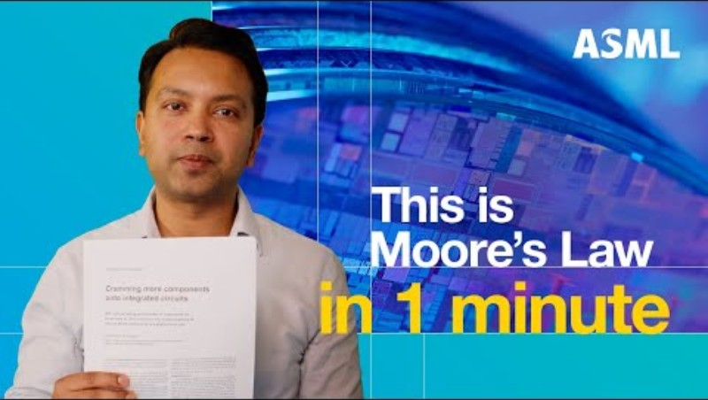
ASML (2024, December 19). What is Moore’s Law? Is it still relevant? Episode 3 | ASML Nanoland [Video]. YouTube. https://youtu.be/C7BCCrCoU3A?si=drqVDN87wMa2L7Vs

Slide 9
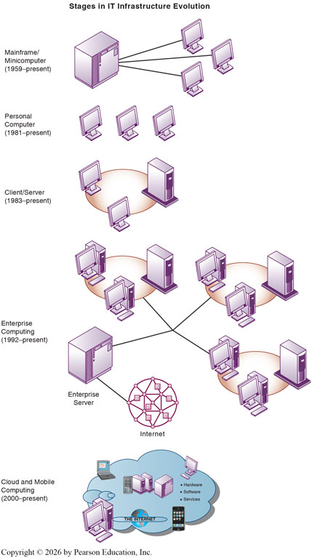
Evolution of IT Infrastructure
Today’s IT infrastructure is the result of more than 70 years of technological evolution in computing and communications.
Each stage has expanded computing power while reducing costs, reshaping how organizations process and share information.
The evolution of computing can be divided into five major eras:
General-Purpose Mainframe and Minicomputer Computing
Personal Computer Era
Client/Server Computing
Enterprise Computing
Cloud and Mobile Computing

Slide 10
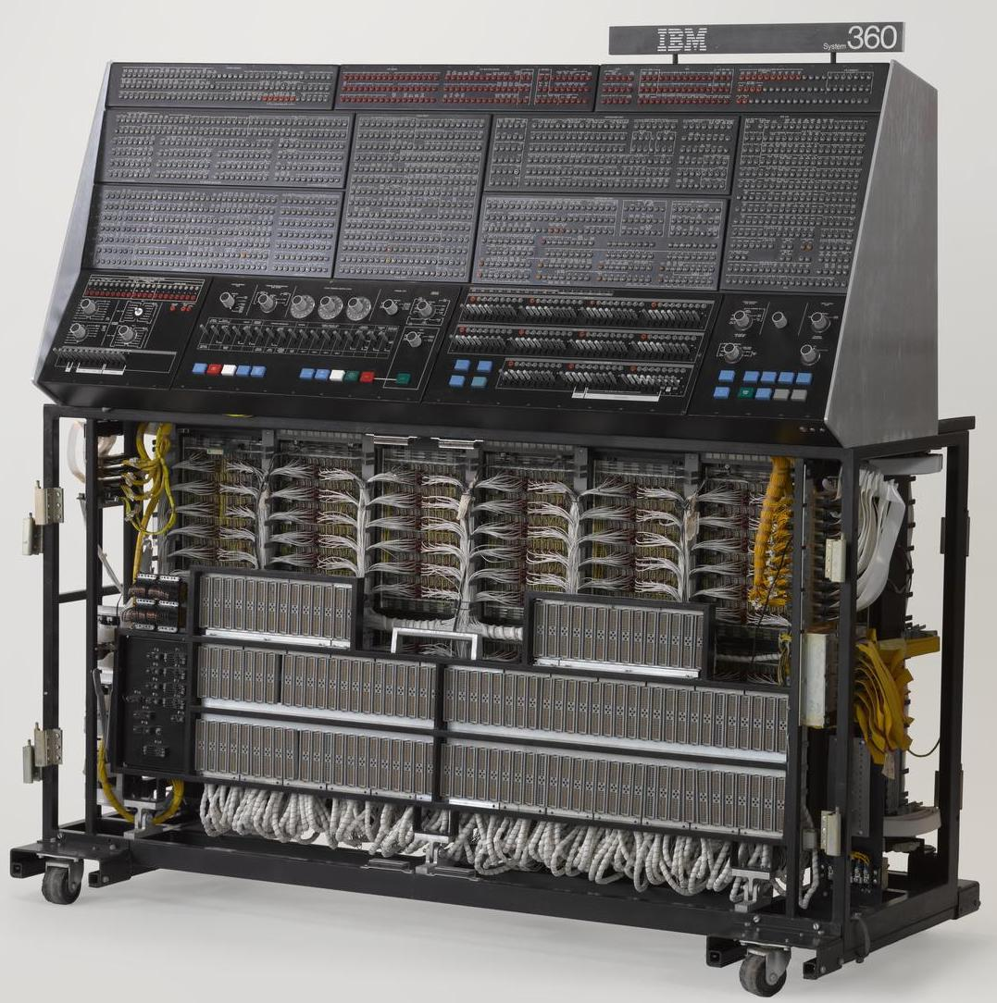
Mainframe and Minicomputer Era (1959–Present)
The mainframe era featured centralized computing managed by professional operators and programmers, dominated by vendors such as IBM.
Minicomputers later introduced departmental computing, offering flexibility for smaller units within firms.
Mainframes remain essential in industries such as finance and healthcare for high-volume transaction processing and secure data handling.

Slide 11
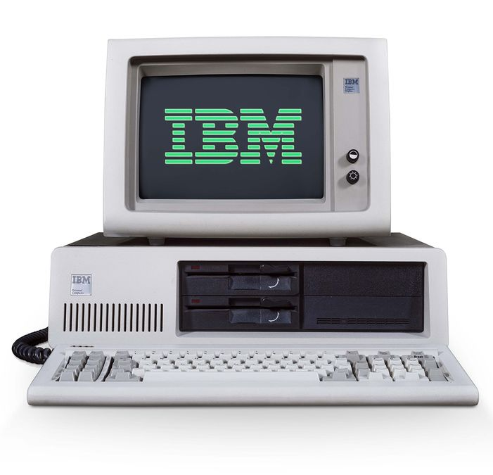
Personal Computer Era (1981–Present)
The personal computer decentralized computing by giving individuals affordable access to data processing.
PCs running Intel processors and Microsoft Windows became standard tools for productivity applications like spreadsheets and word processing.
The PC era empowered employees and departments to manage data independently of central IT departments.

Slide 12
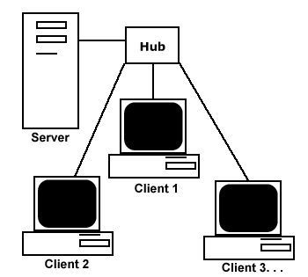
Client/Server Era (1983–Present)
The client/server model connected PCs (clients) to more powerful server computers through networks.
Client: Devices that can request access to services or resources.
Server: Computers that are dedicated to performing common functions that the clients in the network need.
Servers typically carried out tasks such as:
File storage
Software applications
Printing
Internet Access

Slide 13
Client/Server Era (1983–Present)
Processing tasks are divided between clients and servers, allowing workloads to be distributed efficiently across multiple inexpensive machines.
Enabled firms to expand computing capacity without relying on costly centralized systems.
Client/server computing also laid the foundation the development of the Internet.

Slide 14
Client/Server Era (1983–Present)
The simplest model, a two-tiered client/server architecture, consists of a single client computer and a single server computer.
Modern businesses employ a multitiered (N-tier) client/server architecture that balances the network over multiple servers.
Web servers are responsible for locating and managing stored web pages and delivering them to a client in response to a request for service.
Application servers handle all application operations between a browser-based client and an organization’s back-end business applications or databases

Slide 15
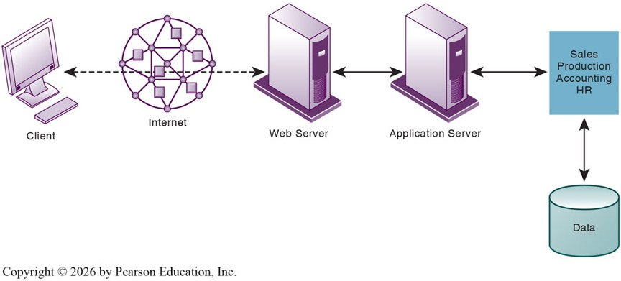
Client/Server Era (1983–Present)

Slide 16
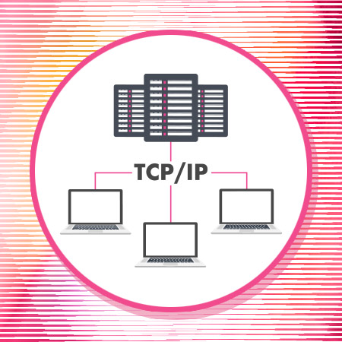
Enterprise Computing Era (1992–Present)
Introduced network standards and protocols that allowed different hardware and networks to communicate seamlessly.
Organizations began integrating previously separate systems into enterprise-wide networks, where information could move freely.
This connectivity extended beyond the firm, linking firms with suppliers, partners, and customers.
Emphasized integration and scalability, enabling firms to coordinate complex operations globally.

Slide 17
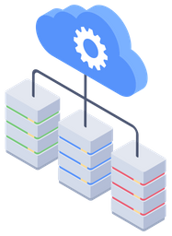
Cloud and Mobile Computing Era (2000–Present)
In the cloud and mobile computing era, data and applications are stored in remote cloud data centers accessible through the Internet.
Users access resources from various devices, computers, smartphones, and tablets, without maintaining local infrastructure.
Computing, storage, and application development take place in the cloud, while firms subscribe to services on demand.
This model allows organizations to scale resources flexibly, reduce costs, and support a mobile workforce operating from anywhere.

Slide 18
IT Infrastructure Evolution
Each new era builds upon the previous one rather than completely replacing it.
Mainframes still handle mission-critical operations, while cloud systems provide agility and global connectivity.
Understanding these eras helps explain how firms adapt infrastructure to changing technological and business needs.
As IT infrastructure has evolved through successive technological eras, each generation has introduced new components that work together to form the backbone of today’s digital firms.
In the next section, we will examine these components in detail.

Slide 19
Components of IT Infrastructure

Slide 20
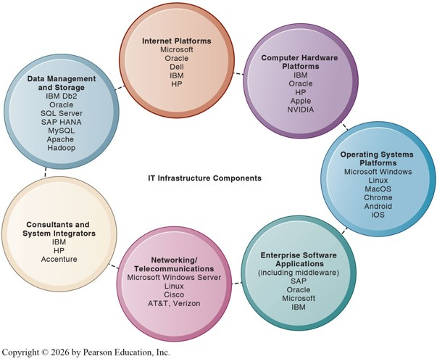
Overview of IT Infrastructure Components
Modern IT infrastructure consists of seven major components that work together to support all business systems.
These components represent critical investments that must be coordinated to provide a unified and efficient technological foundation.
The seventh, enterprise software applications, will be covered in the next subchapter.

Slide 21
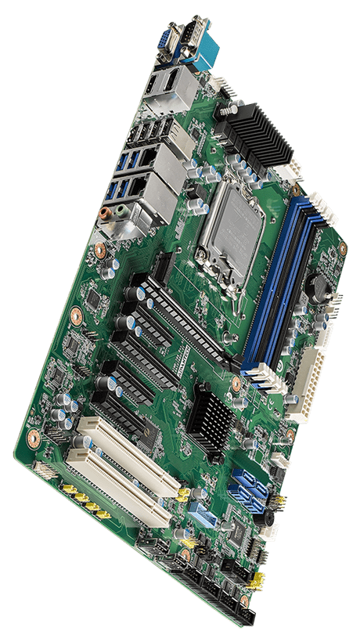
Computer Hardware Platforms
Computer hardware provides the physical foundation for data processing and system operation.
It includes mainframes, servers, desktops, tablets, smartphones, sensors, and wearable devices such as smartwatches.
For decades, most computers used chips from Intel and AMD, but demand for AI-capable hardware has elevated NVIDIA as a major supplier of graphics processing units (GPUs).
These GPUs handle massive datasets for training and running artificial intelligence models.

Slide 22
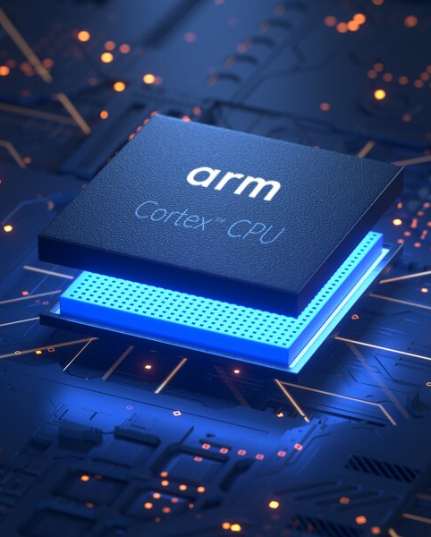
The Rise of Mobile Hardware
The hardware platform expanded with the introduction of mobile devices.
Today, more than 7 billion smartphones are in use world-wide, creating a new consumer-driven hardware platform.
Mobile processors are designed to be lightweight and energy-efficient, consuming less power and generating less heat than traditional computers.
Companies like Apple, Samsung, and Qualcomm use the ARM Holdings architecture to produce chips optimized for mobile computing.

Slide 23
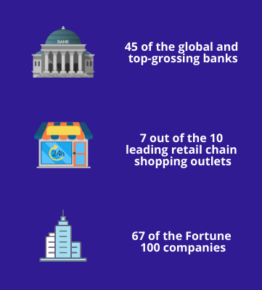
The Continuing Role of Mainframes
Despite advances in mobile and cloud technology, mainframes remain essential for secure, large-scale computing.
They are used extensively in finance, healthcare, manufacturing, and telecommunications for processing massive transaction volumes.
IBM remains the leading producer, adapting its mainframes to function as high-performance servers for enterprise networks.

Slide 24
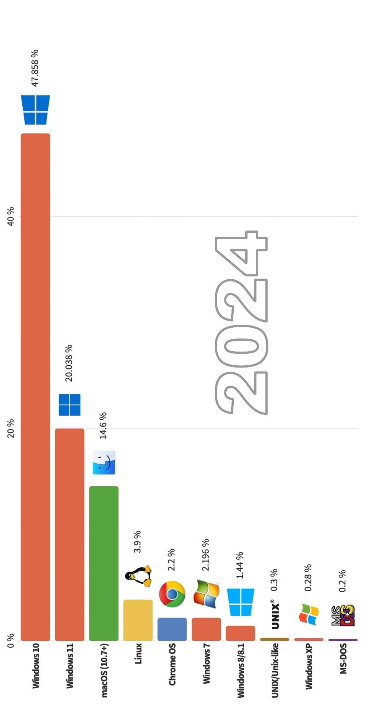
Operating System Platforms
Operating systems (OS) manage and coordinate the activities of a computer and its users.
More than two-thirds of desktop computers and tablets run some version of Microsoft Windows.
Newer operating systems have emerged for mobile and cloud-connected devices, such as Google Chrome OS, which stores data and applications online.
Android (developed by Google) and iOS (by Apple) dominate mobile platforms, while Windows Server and Linux remain the main choices for corporate servers.

Slide 25

Data Management and Storage Platforms
Data management systems organize and store information for operations, analysis, and decision-making.
Major providers include IBM (Db2), Oracle Database, Microsoft SQL Server, and SAP HANA, with both on-premises and cloud versions available.
MySQL, an open-source relational database, and Apache Hadoop, a framework for managing massive datasets, are also widely used.
These systems ensure secure, efficient, and reliable access to organizational data.

Slide 26
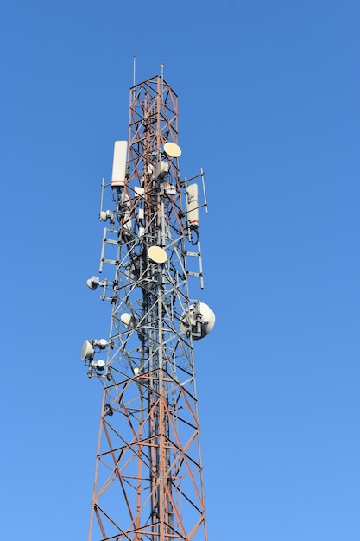
Networking and Telecommunications Platforms
Network Operating Systems (NOS) connect devices across local and wide-area networks, enabling resource sharing and communication.
The leading NOS platforms are Windows Server and Linux.
Key telecommunications hardware providers include Huawei, Nokia, Ericsson, and Cisco Systems, while service providers such as AT&T and Verizon deliver global connectivity.
The rapid growth of wireless, high-speed Internet, and cellular services has made networking one of the fastest-evolving areas of IT infrastructure.

Slide 27
Internet Platforms and Development Tools
Internet platforms include the hardware, software, and services that support a firm’s websites, web applications, and digital services.
Organizations may host these systems in-house or outsource them to providers offering web-hosting and cloud infrastructure.
The widespread use of the internet led to an explosion of servers, later consolidated through virtualization and cloud computing.
The hardware market is dominated by Dell, Cisco, HPE, IBM, and Oracle, while software tools such as Microsoft Visual Studio, .NET, and Oracle’s developer suites enable firms to build and manage secure, scalable web applications.
These combined platforms form the technological foundation for online business, e-commerce, and internal communication systems.

Slide 28
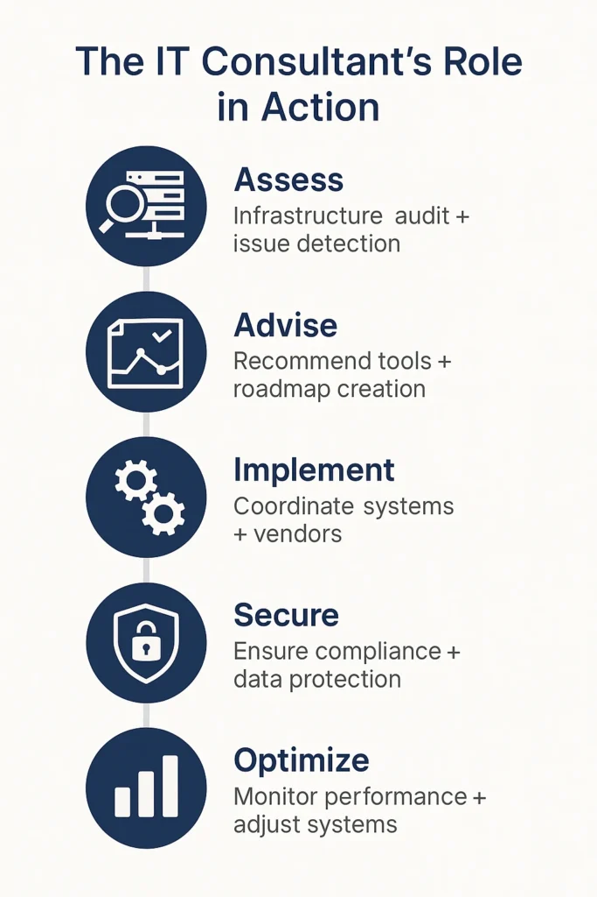
Consulting and System Integration Services
Even large firms often lack the expertise or resources to design and maintain their entire IT infrastructure.
Consulting and integration services help organizations implement new systems, train employees, and ensure compatibility with existing technologies.
Leading firms include Accenture, IBM Services, HPE, Infosys, and Wipro, which assist businesses with digital transformation and cloud migration.
System integration ensures that legacy systems continue to function with new infrastructure components.

Slide 29
Integrating Vendors and Legacy Systems
In the past, vendors offered proprietary systems that could not interact with products from other providers.
Today, firms and vendors work through strategic partnerships to ensure compatibility and flexibility.
Modern IT infrastructure is increasingly hybrid, combining on-site, cloud-based, and outsourced services.
As we understand the components that make up modern IT infrastructure, it becomes clear that computing power and access are no longer limited to traditional devices.
The next section explores the mobile platform, apps, and the Bring Your Own Device movement, showing how these technologies extend infrastructure to the user level.

Slide 30
Mobile Platform, Apps, and BYOD

Slide 31
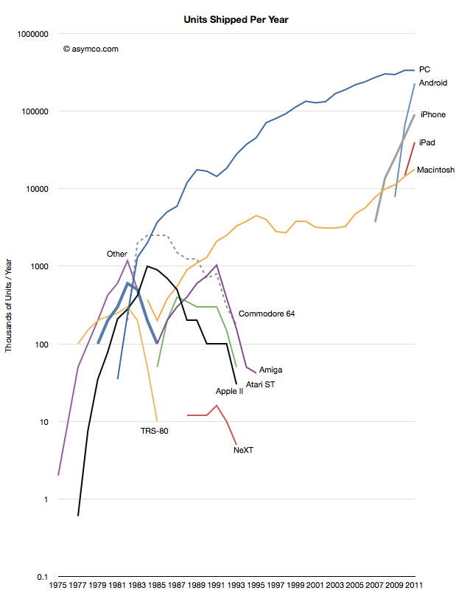
The Rise of Mobile Computing
Advances in computer hardware and networking have transformed how firms organize their computing power.
Businesses now distribute computing capabilities across networks, mobile devices, and cloud-based services, rather than relying solely on centralized systems.
This shift has given rise to the mobile computing platform, which extends enterprise access to employees, customers, and partners anywhere, anytime.

Slide 32
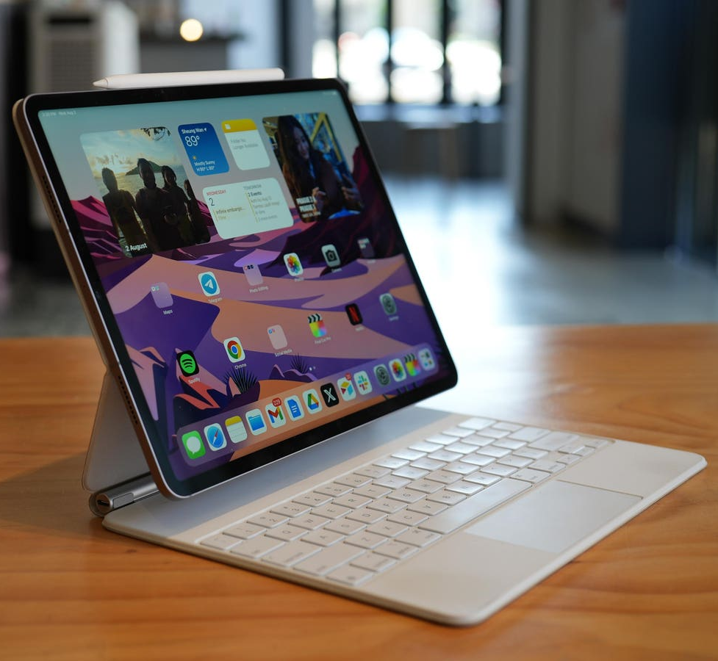
The Mobile Platform
A mobile computing platform functions as an alternative to desktop or mainframe systems.
Smartphones and tablets perform tasks once limited to computers, such as web browsing and data exchange with corporate systems.
The platform also includes Chromebooks, iPads, wearables, and e-book readers.
For many users, mobile devices are now the primary means of accessing the Internet.

Slide 33
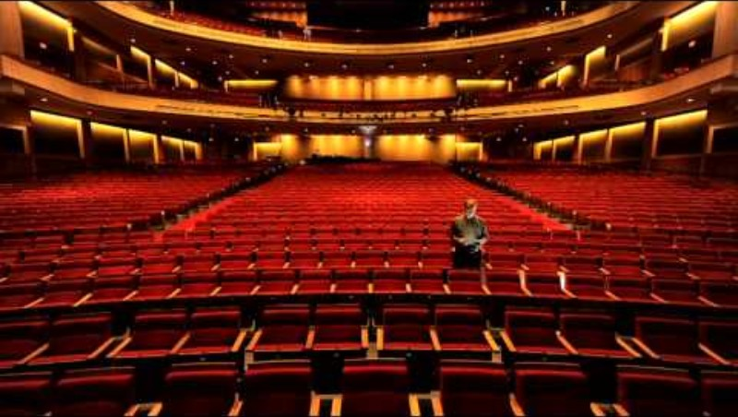
tano9999 (2012, February 10). Apple - iPad in Business - Profiles - Theatre Consultants Collaborative [Video]. YouTube. https://youtu.be/06ab31NEhG8?si=unxqTCyN4oeMz8-X

Slide 34
Business Uses of Mobile Devices
Smartphones and tablets are becoming the primary means of accessing the Internet and conducting business tasks.
Many firms equip employees with mobile devices for real-time access to sales data, scheduling tools, and communication systems.
For example, PepsiCo managers use iPads customized to track team performance, view pricing and contracts, and coordinate deliveries with merchandising teams.
Mobile computing enables faster decision-making, greater responsiveness, and improved field productivity.

Slide 35
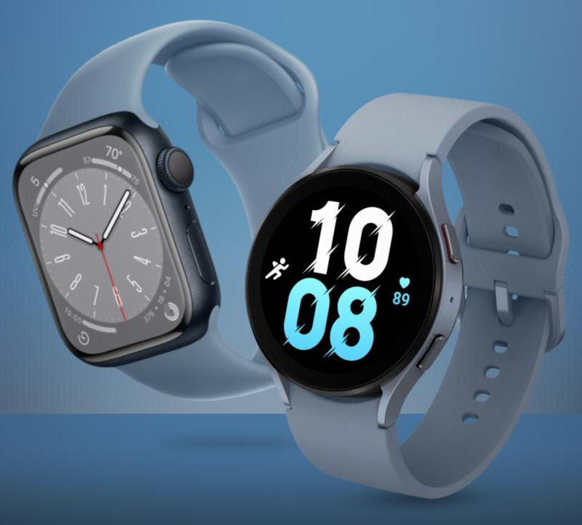
Wearable Computing Devices
Wearable computing devices are a recent addition to the mobile platform.
These include smartwatches, smart glasses, smart badges, and activity trackers.
Wearables can enhance efficiency by delivering information directly to workers without interrupting workflow.
As the technology matures, wearable devices are expected to play a larger role in logistics, healthcare, and industrial operations.

Slide 36
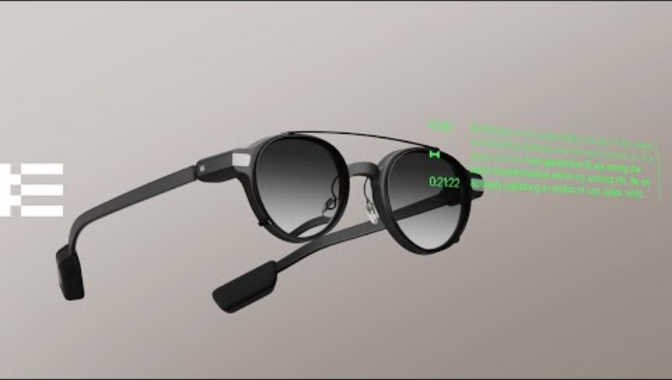
Even Realities (2025, June 13). Even G1: The Everyday Display Smart Glasses [Video]. YouTube. https://youtu.be/Y94XcWKwOik?si=4io0uwhQP-aSlwKv

Slide 37
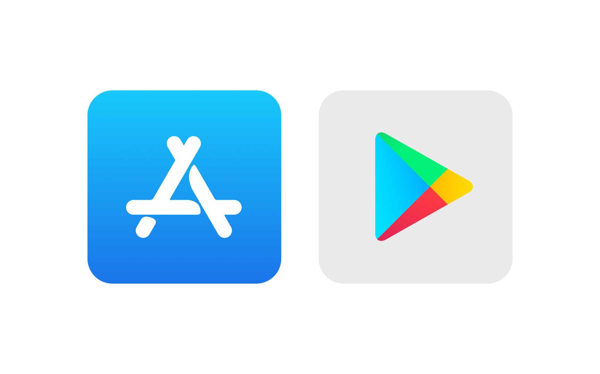
Understanding Apps
An app is a software program that can be accessed via the internet and installed on a user’s device.
While the term can refer broadly to online services, it is most commonly associated with applications for the mobile platform.
Apps transform smartphones and tablets into general-purpose computing tools, giving users access to an enormous variety of functions.
There are now millions of apps available for Apple’s iOS and Google’s Android operating systems.

Slide 38
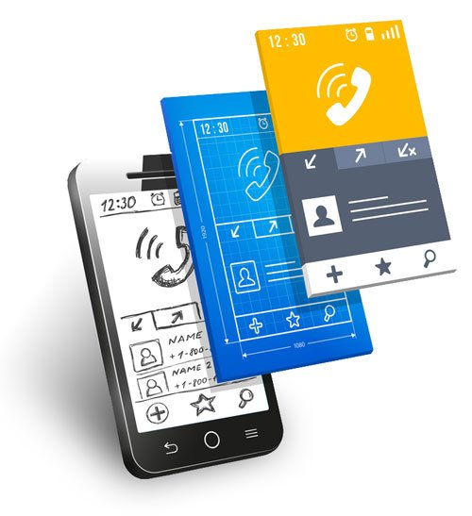
The Role of Apps in Modern Computing
U.S. adults now spend an average of 4.5 hours per day on mobile phones (Volz, 2024).
Companies increasingly redesign websites to mirror the simplicity and usability of mobile apps.
Low-cost or free app availability contributes to widespread global adoption.

Slide 39
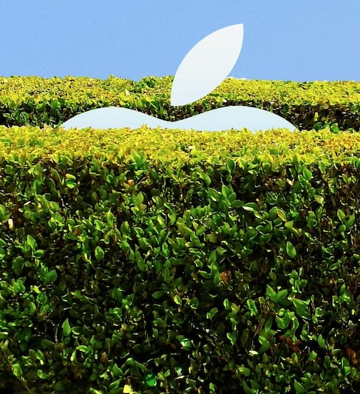
Apps and Platform Dependence
The success of mobile platforms depends on the quantity and quality of available apps.
Apps tie users to a specific platform, as iOS and Android applications are not cross-compatible.
As users accumulate apps, the cost of switching platforms increases, fostering long-term brand loyalty.
This interdependence between hardware and software ecosystems drives competition among mobile providers.

Slide 40
The Consumerization of IT
The consumerization of information technology refers to the spread of consumer technologies into business environments.
Employees are bringing consumer devices and applications, such as Gmail, Google Maps, Dropbox, Facebook, and TikTok, into the workplace.
This trend challenges the traditional model in which corporate IT departments selected and controlled all hardware and software.
Departments and individual employees now exert more influence over which tools are used in daily work.

Slide 41
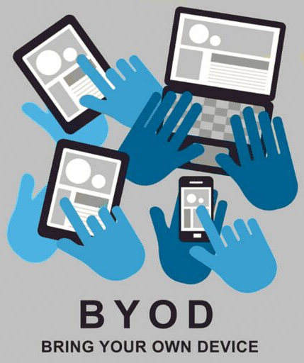
Bring Your Own Device (BYOD)
The BYOD movement encourages employees to use their own personal devices for work-related tasks and network access.
BYOD offers flexibility, convenience, and familiarity, allowing employees to work seamlessly across personal and professional contexts.
However, it also raises serious concerns about data security, privacy, and system management.
The main trade-off is between employee flexibility and organizational control over hardware and information access.

Slide 42
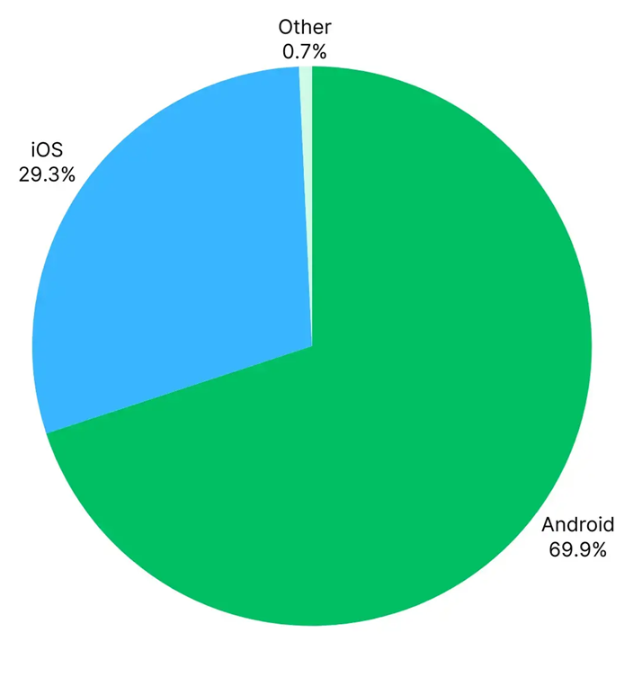
Risks and Management of BYOD
Supporting multiple devices and operating systems requires significant IT oversight.
Apple’s iOS runs as a closed, standardized system, while Android appears on thousands of device models, creating management complexity.
Companies must track employee devices, access permissions, and software versions to prevent data breaches.
Effective BYOD programs rely on clear policies, mobile device management (MDM) tools, and employee training.

Slide 43
Security and Productivity Challenges
BYOD can create vulnerabilities such as data loss, hacking, and unauthorized access to corporate networks.
Lost or stolen devices can expose sensitive data if not properly encrypted or remotely managed.
Some organizations deploy remote-wipe or encryption technologies to safeguard information.
Productivity may also decline if employees use devices for personal activities during work hours.
Mobile and cloud technologies have expanded how we access computing power, making it portable and personalized.
In the next section, we explore how that power itself is evolving

Slide 44
Quantum Computing and Green Computing

Slide 45
Emerging Trends in IT Infrastructure
Two major trends are transforming IT infrastructure: quantum computing and green computing.
Quantum computing explores how data can be processed at the subatomic level to achieve exponential increases in speed and capacity.
Green computing focuses on energy efficiency and environmental responsibility in how hardware, software, and data centers are designed and managed.
Together, these developments reflect the drive toward powerful yet sustainable computing.

Slide 46
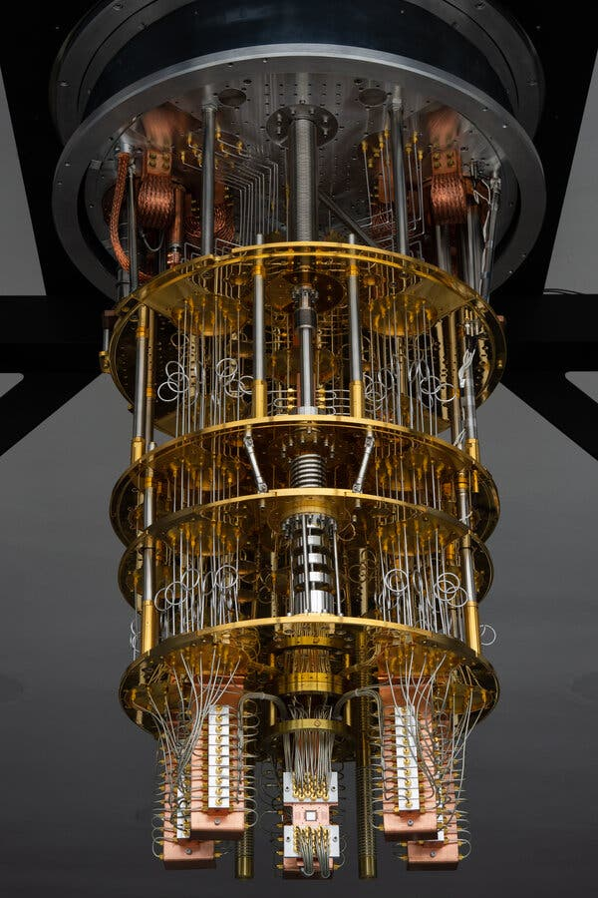
What Is Quantum Computing?
Quantum computing applies the principles of quantum mechanics, where matter and light behave at atomic and subatomic scales.
While classical computers use bits that represent either 0 or 1, quantum computers use qubits, which can exist as 0, 1, or both simultaneously.
This ability allows quantum systems to perform multiple calculations at once, dramatically increasing processing power.
Even small-scale quantum systems could surpass today’s most advanced supercomputers.

Slide 47
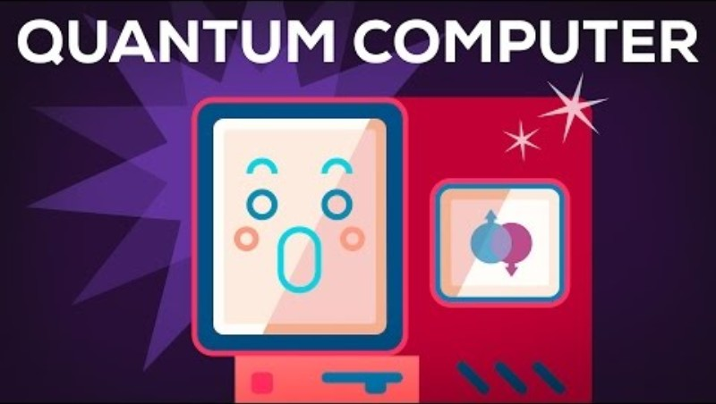
Kurzgesagt – In a Nutshell (2015, December 8). Quantum Computers Explained – Limits of Human Technology [Video]. YouTube. https://youtu.be/JhHMJCUmq28?si=c_xo7R0nTctnqW1u

Slide 48

How Quantum Computing Works
Quantum computers gain their capability through superposition, enabling qubits to occupy multiple states at the same time.
This makes them ideal for solving problems involving optimization, cryptography, and scientific simulations.
Quantum computing could complete in seconds what traditional machines might take years to calculate.
Most systems remain experimental as researchers work to improve stability, scalability, and accuracy.

Slide 49
Benefits and Limitations of Quantum Computing
Benefits:
Up to 158 times faster than conventional systems.
Solves complex problems and simulations that traditional computers cannot handle.
Enhances AI and machine learning by processing vast datasets for optimization tasks.
Limitations:
Requires extreme cooling and high energy consumption to maintain superconductivity.
Qubits are fragile and prone to errors and interference from the environment.
Raises future security risks, as quantum systems may weaken existing encryption methods.

Slide 50

Introducing Green Computing
Green computing, or green IT, aims to minimize the environmental impact of technology across its entire lifecycle.
It includes the design, use, and disposal of computers and IT equipment to reduce energy use, emissions, and electronic waste.
Energy efficiency and sustainability have become essential business priorities for both cost savings and corporate responsibility.

Slide 51
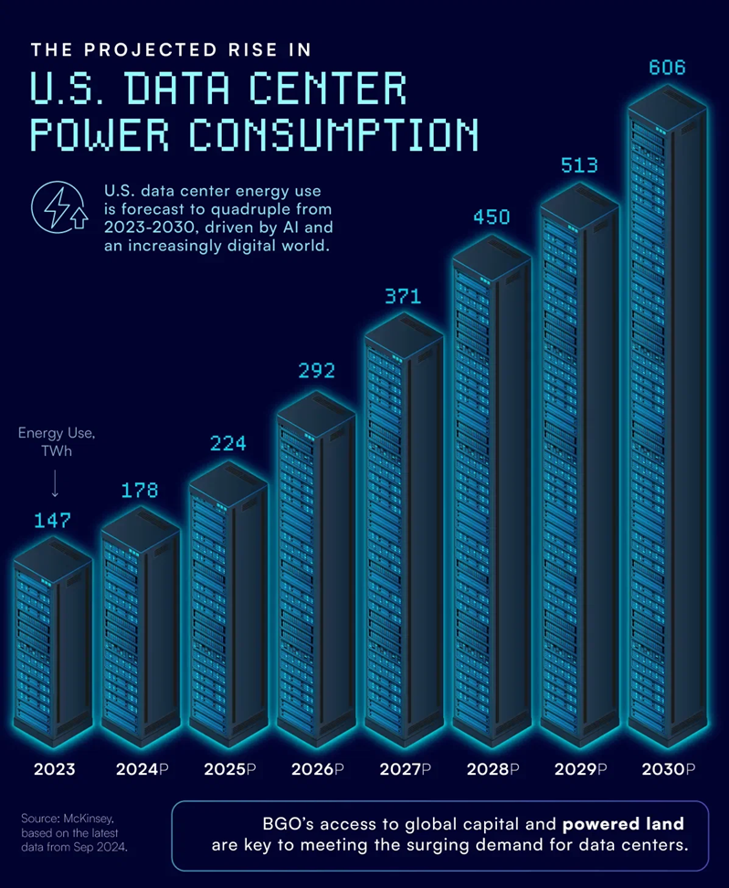
Data Centers and Energy Use
A typical data center can consume more than 100 times the power of a standard office building, increasing operational costs and carbon emissions.
U.S. residential electricity consumption in 2023 was 1,450 TWh.
To address these issues, firms are adopting energy-efficient air-cooling systems, renewable power sources, and low-power processors.
Many organizations are migrating to cloud computing to consolidate resources and reduce wasteful energy use.

Slide 52
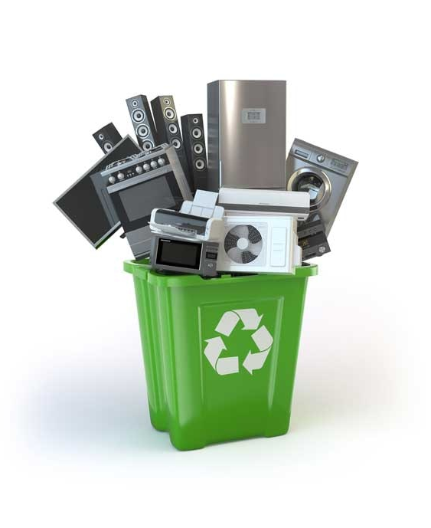
Green Computing Practices
Energy-efficient hardware: Use devices and processors that minimize power consumption.
E-waste reduction: Recycle and properly dispose of outdated electronics under environmental regulations.
Optimized systems: Apply IoT sensors and AI tools to manage energy use in data centers automatically.
Renewable energy: Use wind, hydroelectric, or geothermal power to operate computing facilities sustainably.

Slide 53
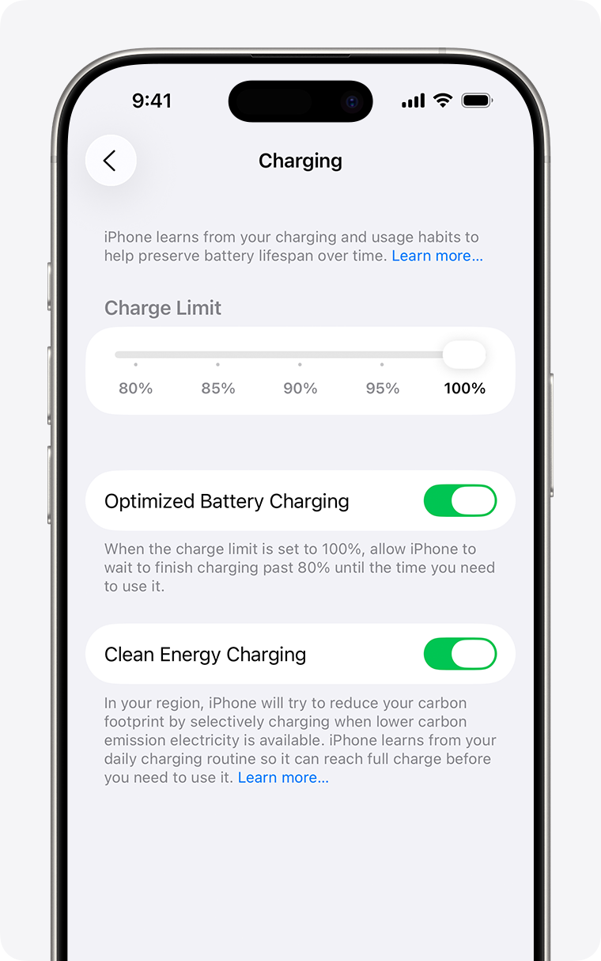
Sustainable Software and Virtualization
Sustainable software includes tools that measure and reduce digital emissions and encourage efficient coding practices.
Developers now emphasize green coding, optimizing algorithms and reducing code complexity to conserve computing resources.
Server virtualization allows multiple virtual machines to run on one physical server, improving efficiency and reducing CO₂ emissions.
Remote work policies also contribute by lowering commuting and building energy costs.

Slide 54
The Future of Sustainable Computing
As AI and data processing expand, energy consumption and e-waste are becoming critical sustainability challenges.
Firms must balance the pursuit of computing power with the need to protect environmental resources.
As firms pursue high-performance and sustainable computing, they are also rethinking how resources are structured and delivered.
The next section explores virtualization and cloud computing, technologies that enable scalability, flexibility, and more efficient use of energy and infrastructure.

Slide 55
Virtualization and Cloud Computing

Slide 56
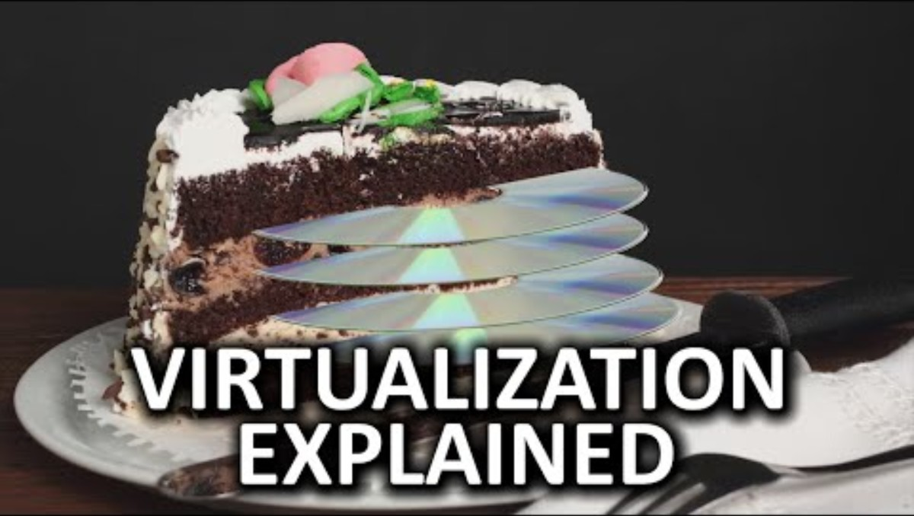
Techquickie (2015, November 6).Virtualization As Fast As Possible [Video]. YouTube. https://youtu.be/XItj08D5KPk?si=SzoAxbf7Tf46R-mf

Slide 57
Virtualization
Virtualization uses software to create virtual versions of servers, storage, networks, and other hardware on a single physical system.
Allows computing resources to be accessed without regard to physical configuration or location.
Underpins cloud computing by enabling multiple logical systems to run efficiently on shared hardware.
A single physical machine can host multiple operating-system instances, each functioning as a separate virtual server.
To users and applications, each virtual server appears as an independent physical computer.
This technology enables centralized management and greater flexibility in deploying and scaling systems.

Slide 58
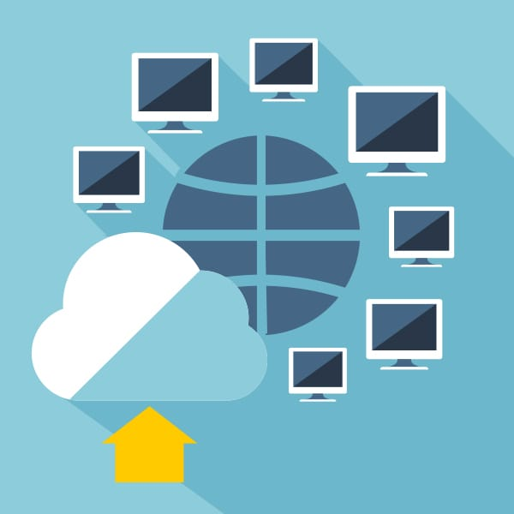
Benefits of Virtualization
Cost reduction: Fewer servers are needed as utilization rates rise from 15~20 percent to as high as 70 percent.
Space and Energy Savings: Consolidating servers reduces data-center footprint and power consumption.
Simplified Administration: Hardware resources can be centrally managed and allocated dynamically.
Scalability: New virtual machines can be created quickly to meet changes in demand.

Slide 59
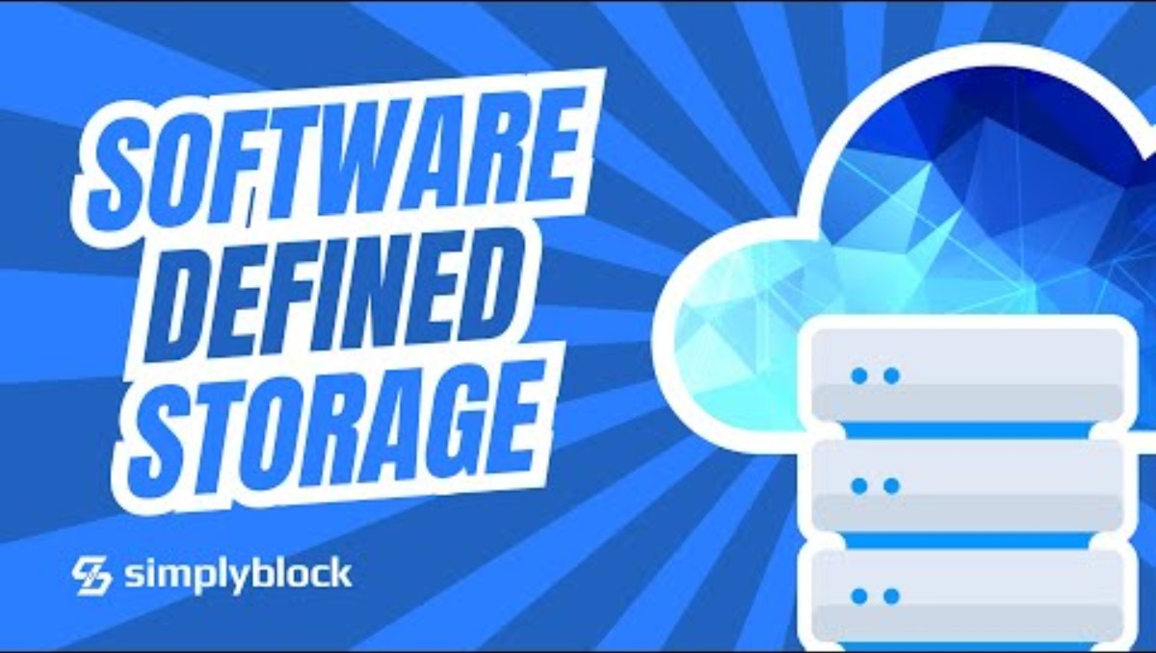
simplyblock (2025, August 29).What Is Software-Defined Storage (SDS)? The Future of Scalable Data Infrastructure 🚀 [Video]. YouTube. https://youtu.be/YCK3NeTZVHc?si=yFsk8Mp5GrXrdt69

Slide 60
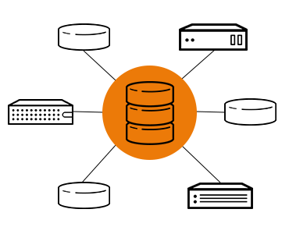
Software-Defined Storage (SDS)
Virtualization can also pool physical storage into a single logical resource using software-defined storage.
SDS separates the software that manages data from the physical storage hardware.
It lets firms use lower-cost commodity hardware while improving efficiency and flexibility in allocating storage.
A crude way of understanding SDS is that it is the ‘virtualization of data storage’.

Slide 61
Virtualization and Cloud Computing
Virtualization is essential to cloud computing because it abstracts physical resources into logical units that can be easily shared and scaled.
Without virtualization, cloud providers would have to allocate entire servers for each client, leading to significant inefficiencies.
High Costs: Without virtualization, more hardware would be required to provide the same service.
Scalability: Consumers would not be able to instantly scale up or down based on demand, as the provider would have to manually configure a new physical server each time.
These capabilities make possible the on-demand delivery of computing resources that defines cloud computing.

Slide 62
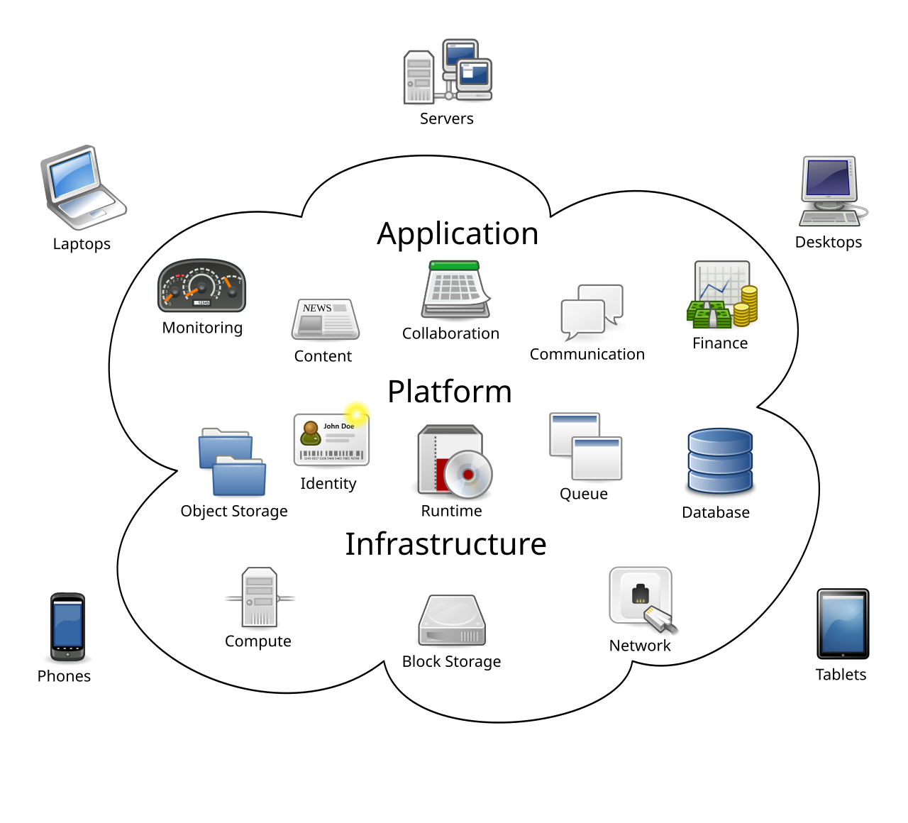
Cloud Computing
Cloud computing is a model in which computing power, storage, and software are delivered as virtualized services over the Internet.
Users access a shared pool of resources from any device and location as needed.
Firms can perform all of their computing work using virtualized infrastructure hosted remotely.

Slide 63

Characteristics of Cloud Computing
The U.S. National Institute of Standards and Technology, identifies five key characteristics of cloud computing:
On-demand Self-service: Users can automatically obtain computing resources such as storage or processing power.
Ubiquitous Network Access: Services are available through standard Internet-connected devices.
Resource Pooling: Providers dynamically allocate shared resources among multiple users.
Rapid Elasticity: Capacity can scale up or down quickly to meet user demand.
Measured Service: Users are billed based on the amount of resources actually consumed.

Slide 64
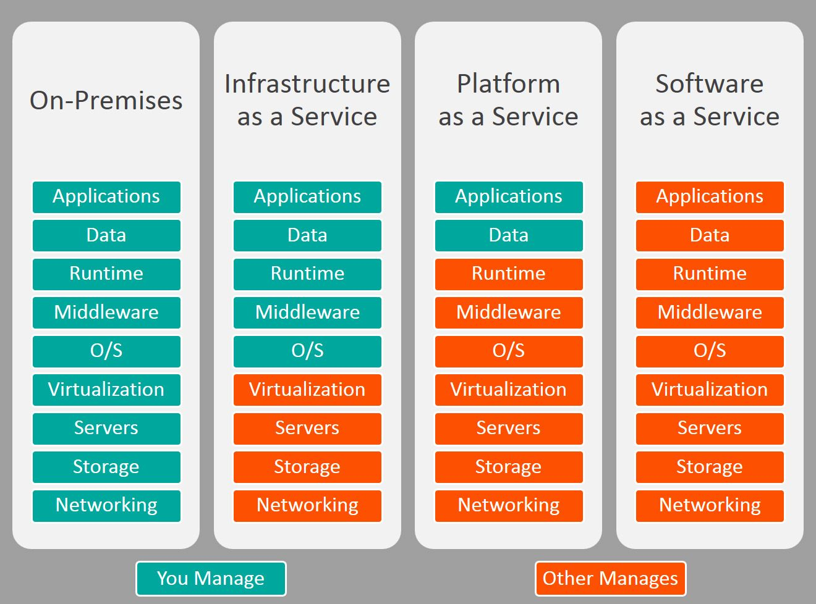
Types of Cloud Services
Infrastructure as a Service (IaaS):
Customers rent processing, storage, and networking from providers such as Amazon Web Services (AWS).
Platform as a Service (PaaS):
Providers supply infrastructure and tools for building and testing applications, as seen with Microsoft Azure or Salesforce Platform.
Software as a Service (SaaS):
Users access vendor-hosted software over the Internet. Examples include Google Workspace, Microsoft 365, and Salesforce CRM.

Slide 65
Advantages and Challenges of Cloud Computing
More than 90 percent of firms worldwide now use some form of cloud service.
Advantages:
Flexibility in computing power and storage.
Cost efficiency through pay-for-use pricing and economies of scale.
Reduced maintenance, as providers handle infrastructure upkeep.
Accessibility, allowing even small firms to use enterprise-level systems.
Challenges:
Data control: Responsibility for storage and security shifts to external providers.
Security and reliability: Outages or breaches can disrupt business operations.
Cost unpredictability: Usage-based pricing can lead to unanticipated expenses.
Integration: Migrating legacy applications to the cloud can require significant redevelopment.

Slide 66
Cloud Deployment Models
Public Cloud:
Operated by providers such as AWS or Google Cloud and shared among many users. Ideal for web hosting, large projects, or consumer services.
Private Cloud:
Built for a single organization to maintain control while retaining cloud flexibility.
e.g. Network Attached Storage (NAS)
Hybrid Cloud:
Combines private infrastructure for critical systems with public clouds for additional capacity during peak periods.

Slide 67
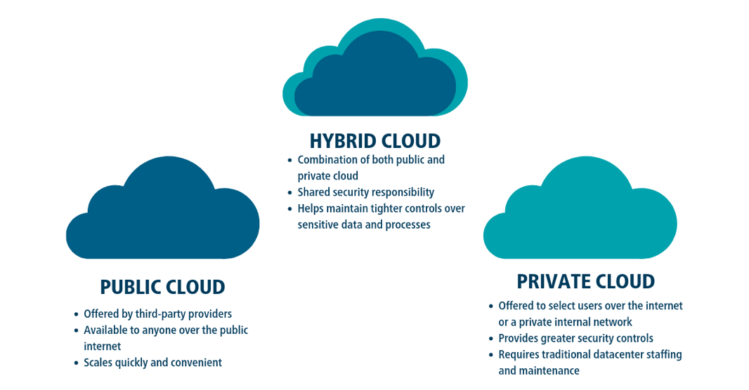
Cloud Deployment Models

Slide 68
Hybrid Cloud and On-Demand Computing
Many large firms adopt a hybrid model, keeping sensitive workloads on private servers while using public clouds for less-critical tasks.
This approach balances security, performance, and cost.
The concept of on-demand computing captures the pay-as-you-go nature of this flexible approach.
Hybrid systems represent the future trend for most mid-sized and large organizations.
All major providers such as AWS, Microsoft Azure, Google Cloud Platform, and Salesforce offer integrated AI services.
These include tools for natural-language processing, image recognition, and predictive analytics delivered through the cloud.
Cloud AI lowers the barrier to entry for machine learning by giving firms access to scalable computational power and pretrained models.

Slide 69
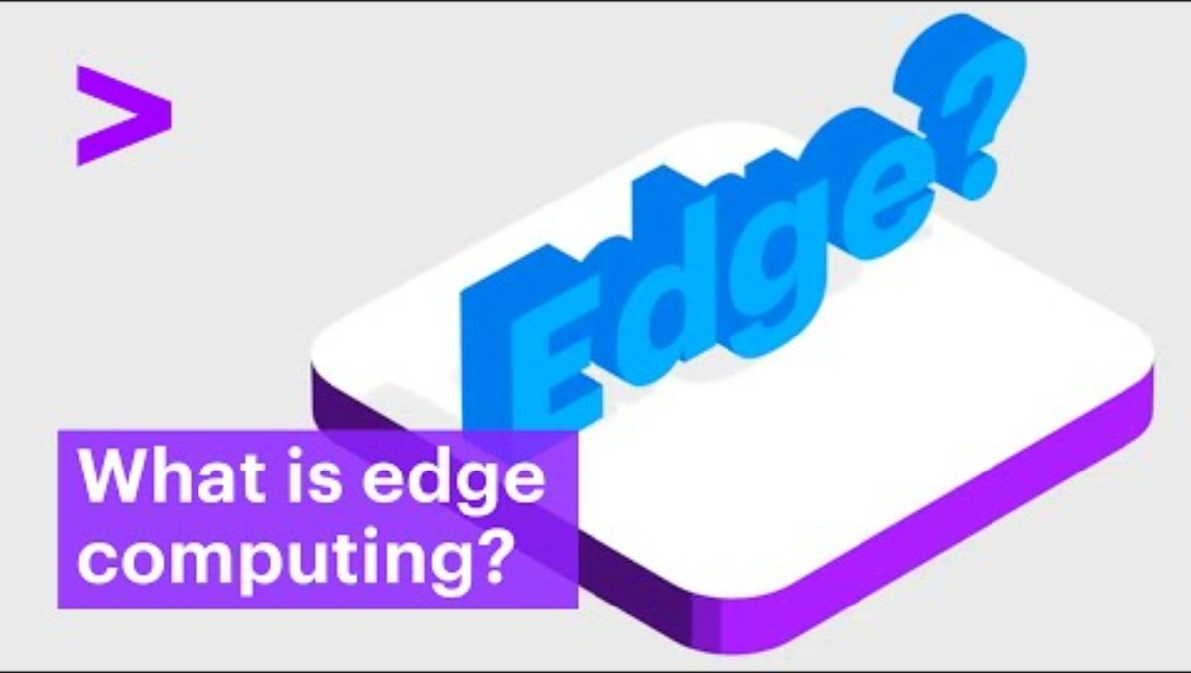
Accenture (2022, October 18). What is Edge Computing? [Video]. YouTube. https://youtu.be/WMvb9LLXzUs?si=-44kOZLrcatKb_NL

Slide 70
Edge Computing
Edge computing processes data closer to its source instead of sending everything to distant data centers.
This approach reduces network delays and bandwidth costs.
It is valuable for IoT applications, where sensors or devices generate large data volumes.
Examples include oil-rig sensors or autonomous vehicles that require real-time data processing.
Benefits of Edge Computing
Reduced latency: Processing near the data source speeds response times for time-sensitive applications.
Lower network load: Only essential data are transmitted to the central cloud.
Improved reliability: Local systems can continue operating even if cloud connectivity is interrupted.
Throughout this chapter, we have explored how modern IT infrastructure has evolved. In the next chapter, we will examine how firms manage and govern their IT infrastructure.

Slide 71
Infrastructure Management

Slide 72
Managing Modern IT Infrastructure
Building and managing a coherent IT infrastructure presents ongoing challenges for every organization.
Firms must navigate technological change, governance and management decisions, and infrastructure investment strategies.
These challenges determine how efficiently and securely a company operates in an increasingly digital environment.
As firms expand, they often outgrow their existing IT infrastructure; when they contract, they may retain excess capacity.
Key Question: How can firms remain flexible when infrastructure investments are often fixed-cost?

Slide 73
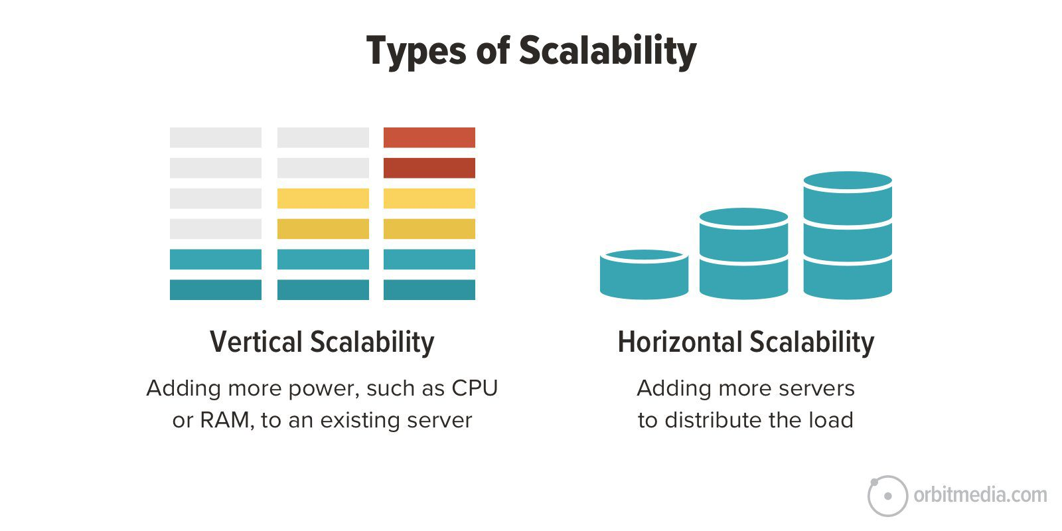
Dealing with Platform and Infrastructure Change
Scalability refers to the ability to expand systems to accommodate more users or applications.
Designing and maintaining scalable IT infrastructure helps firms manage fluctuations effectively.
Ensures systems can handle growth from new applications, mergers, and increased business volume.
Poor scalability can lead to performance failures or underutilized systems.
Infrastructure planning must anticipate future capacity needs and align them with strategic goals.

Slide 74
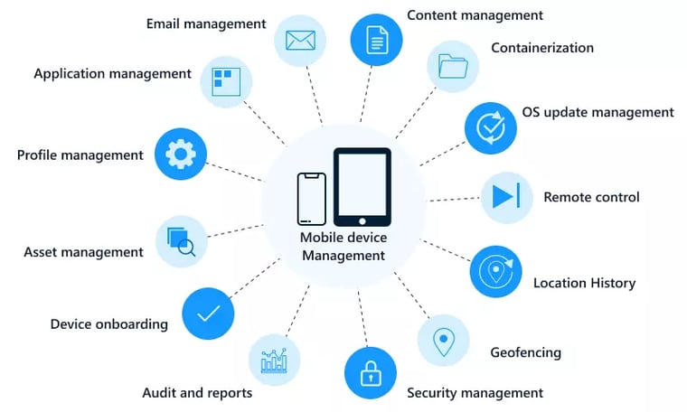
Dealing with Platform and Infrastructure Change
Firms adopting mobile and cloud computing must develop new tools and policies for security, tracking, and performance.
Mobile Device Management (MDM) software helps monitor and secure devices used across multiple operating systems and carriers.
MDM systems can update apps, back up data, and remove information from lost or stolen devices.

Slide 75
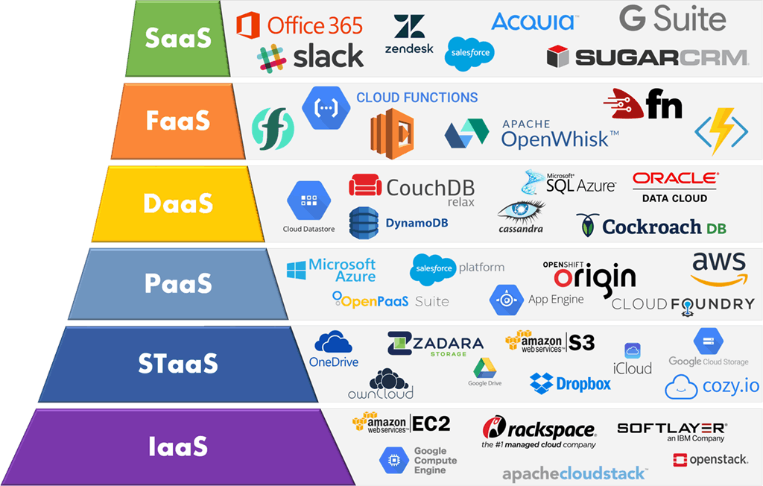
Dealing with Platform and Infrastructure Change
Firms using cloud services must establish clear contractual agreements with vendors.
Define availability standards, response times, and security requirements for critical applications.
Business management must determine acceptable performance benchmarks for outsourced infrastructure.

Slide 76
IT Management and Governance
A central question in IT management is: Who controls and governs the firm’s infrastructure?
IT governance defines how responsibilities are distributed between central IT management and individual business units.
Key governance issues include decision authority, cost allocation, and alignment with business objectives.
Firms must decide whether IT decisions should be centrally managed or distributed among departments.
Centralized governance ensures consistency and standardization but may limit flexibility.
Decentralized governance allows customization but can lead to redundancy and higher costs.
Most firms adopt a hybrid approach, balancing both efficiency and local autonomy.

Slide 77
Making Wise Infrastructure Investments
IT infrastructure represents a major long-term investment.
Spending too much creates idle capacity and wastes resources; spending too little leads to service gaps and competitive disadvantage.
Firms must analyze how much to invest and whether to own or rent infrastructure resources.
Firms must choose between purchasing IT assets or renting them from cloud service providers.
Renting through cloud computing can increase flexibility and scalability but requires careful cost analysis.
Over time, subscription and usage fees may exceed the cost of ownership for some systems.
Firms should balance cost, security, and workflow impacts when making this decision.

Slide 78
Understanding Total Cost of Ownership
Total Cost of Ownership (TCO) analysis helps firms identify hidden costs and evaluate investment alternatives more accurately.
The TCO includes not only purchase and installation costs but also ongoing expenses.
Hardware and software acquisition: Purchase or license of technology.
Installation and training: Costs for setup and employee preparation.
Support and maintenance: Help desk services, upgrades, and system upkeep.
Infrastructure and utilities: Network equipment, data centers, space, and power.
Downtime: Lost productivity due to system failures.
Understanding these factors ensures more informed budgeting and decision-making.

Slide 79
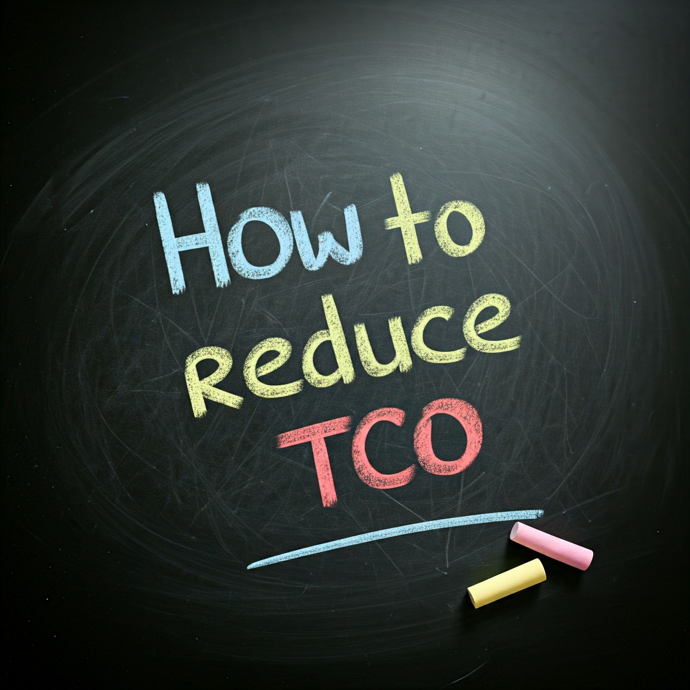
Reducing TCO
Hardware and software purchases account for only about 20 percent of total ownership costs.
The greatest savings come from reducing administrative and support expenses.
Firms can lower costs by:
Standardizing hardware and software.
Centralizing IT management.
Using cloud services for scalable storage and computing.

Slide 80
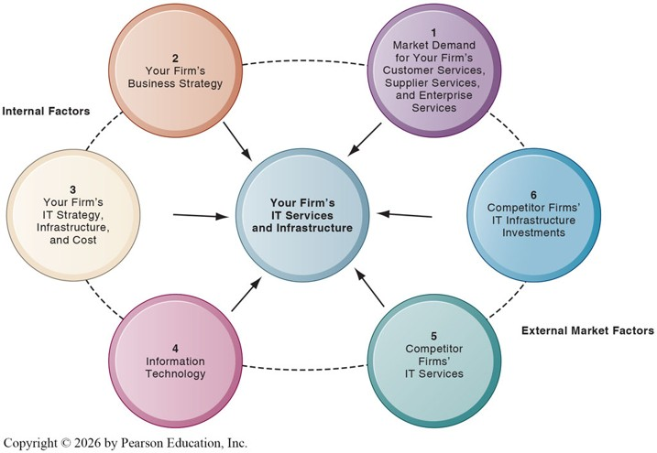
Competitive Forces Model for IT Infrastructure
The Competitive Forces Model helps firms determine how much to invest in IT infrastructure and where to direct those investments.
The goal is to align IT spending with business strategy, market demand, and competitive positioning.

Slide 81
Factors in the Model
Your business strategy: Identify future services and capabilities required to achieve strategic goals.
Your IT strategy, infrastructure, and cost: Assess alignment with business objectives and evaluate total IT costs.
Information technology assessment: Determine whether the firm is technologically outdated or investing too far ahead of standards.
Market demand: Evaluate customer, supplier, and employee needs for faster or higher-quality digital services.
Competitor firm services: Compare your technology offerings and service levels with those of competitors.
Competitor IT investments: Benchmark IT spending and innovation strategies to maintain competitive advantage.

Slide 82
Recap of Chapter 5

Slide 83
Recap of Chapter 5
Discuss IT infrastructure and its evolution
Describe the components of IT infrastructure
Discuss the mobile platform, apps, and BYOD
Discuss quantum computing and green computing
Discuss virtualization and cloud computing
Discuss IT infrastructure management challenges

